Slide 1
APUSH Review: Pueblo Revolt (Pope’s Rebellion)
www.Apushreview.com
Everything You Need To Know About The Pueblo Revolt To Succeed In APUSH

Slide 2
The New Curriculum And The Pueblo Revolt
Key Concept 2.2, II, B: “Spanish colonizing efforts in North America, particularly after the Pueblo Revolt, saw an accommodation with some aspects of American Indian culture; by contrast, conflict with American Indians tended to reinforce English colonists’ worldviews on land and gender roles.”
Page 30 of the Curriculum framework
The Pueblo Revolt was a watershed event in Spanish colonization
Since it is mentioned specifically, you should be very familiar with it

Slide 3
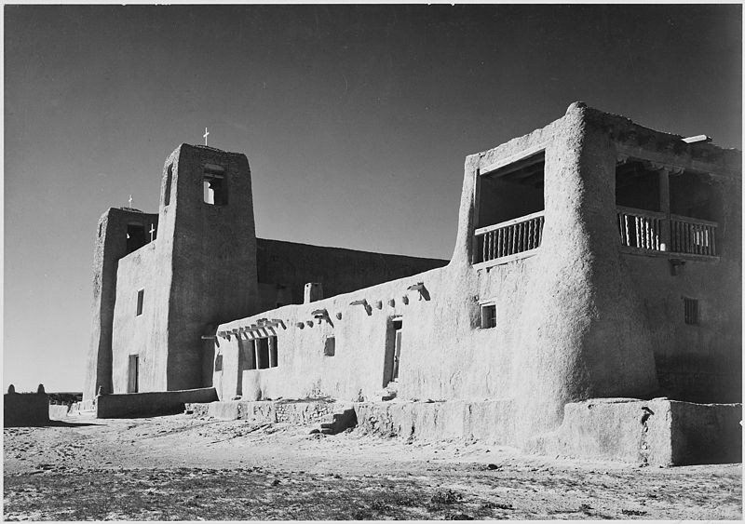
Background Info
Pueblos:
Native Americans that were located in Rio Grande region of the southwestern US (New Mexico, Arizona)
Pueblo is Spanish for town; named after their distinct buildings
Don Juan de Onate defeated the Pueblos
Spanish established Santa Fe in 1610
Spanish ruled the Pueblos harshly
2,000 Spanish and 30,000 Pueblos

Slide 4
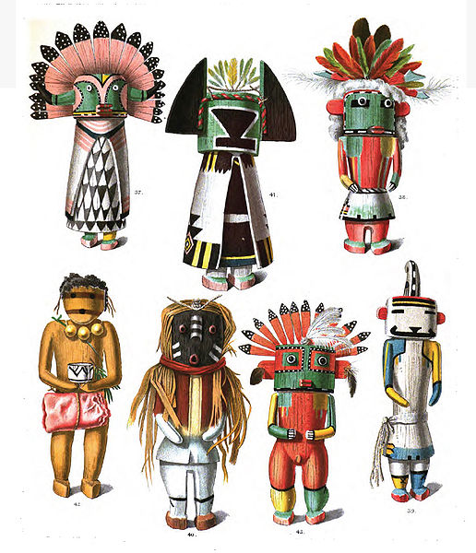
The Rebellion
Why did it occur?
Spanish priests and government suppressed Native practices that were inconsistent with Christianity
Spanish demanded tribute and labor from Natives
What happened?
Pope (Native religious leader) killed hundreds and forced Spanish to flee
Spain regained control in 1696
Significance?
Spanish sought to religiously assimilate the Natives
Pueblos were given more freedoms from the Spanish

Slide 5
Test Tips
Multiple-Choice Questions:
Impact of the revolt – Spanish were more accommodating
Essay Questions:
Comparing Spanish interactions with Natives against the French and English

Slide 6
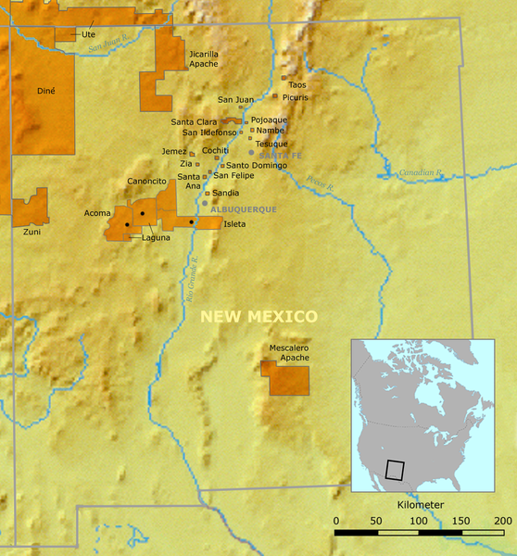
Thanks for watching!
Subscribe to my channel
Help spread the word
Questions? Comments?
Leave in comments
Subscribe
Down here!

